Slide 1
Project Falcon Review
Pilot results, sales and next steps
Test deck - every slide type

Slide 2
1
Pilot results
What changed in the first quarter

Slide 3
OVERVIEW
Summary
Speed: processing time down 40% in the pilot
Onboarding: new teams productive in days, not weeks
Cost: lower cloud spend after moving batch jobs
Reliability: 99.9% uptime across the pilot
Notes:
Seven bullets so this splits onto a continuation slide.

Slide 4
OVERVIEW
Summary (cont.)
Adoption: 1,200 users by end of quarter
Feedback: most requests are for more integrations
Risk: single region deployment still
!
Next review: after the Q3 rollout to two more regions.
Notes:
Seven bullets so this splits onto a continuation slide.

Slide 5
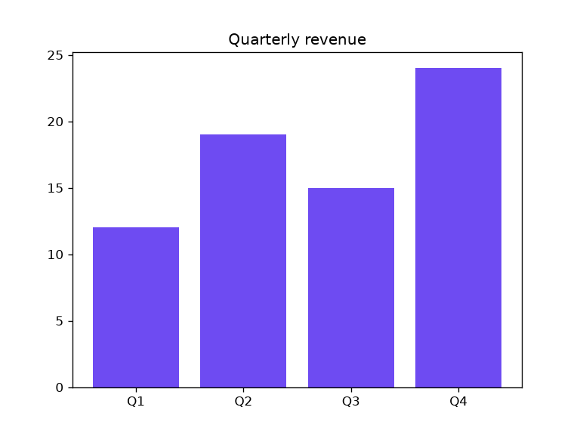
Quarterly revenue
Q4 best quarter: 24 units
Q2 strong start
Q3 dip from a delayed release

Slide 6
Why it worked
1
2
3
Faster onboarding
Lower cost
Fewer incidents
Templates and defaults remove most of the setup work.
Batch jobs run on spot capacity overnight.
Health checks catch bad deploys before users notice.

Slide 7
Four focus areas
S
Security
R
Scale
SSO everywhere by Q3.
Second region live.
H
Support
D
Docs
24h response target.
Every API documented with examples.

Slide 8
Rollout plan
Prepare
Freeze config, back up data, notify teams.
1
Migrate
Move one team at a time, verify each before the next.
2
Monitor
Watch error rates and latency for 48 hours.
3
Close out
Remove the old system and update docs.
4

Slide 9
Pilot in numbers
40%
1,200
99.9%
faster processing
active users
uptime
Source: pilot report, table 1.

Slide 10
Deploy command
!
Run as Administrator: the script registers a Windows service.
POWERSHELL
.\deploy.ps1 -Env prod `
-Region west `
-Confirm

Slide 11
Sales by region
Quarter | North | South
Q1 | 12 | 9
Q2 | 19 | 14
Q3 | 15 | 18
Q4 | 24 | 21

Slide 12
Sales by region
South overtook North in Q3: new distributor signed in July.

Slide 13
Share of Q4 sales

Slide 14
Trend

Slide 15
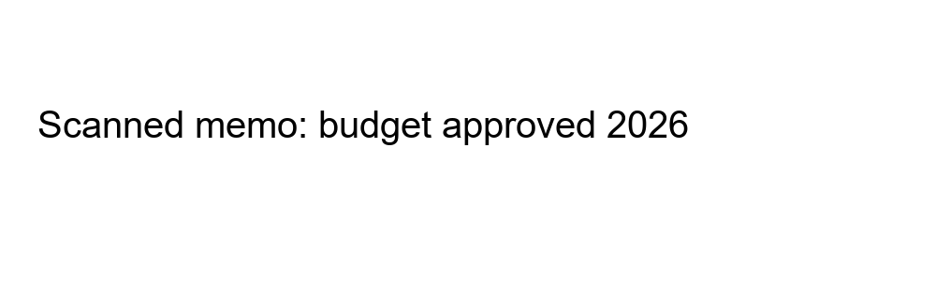
Scanned approval memo
Approved for 2026
Covers both regions
Budget approval, scanned copy

Slide 16
Takeaways
✓
Pilot hit every target
✓
Roll out region by region
✓
Next review after Q3

